Slide 1
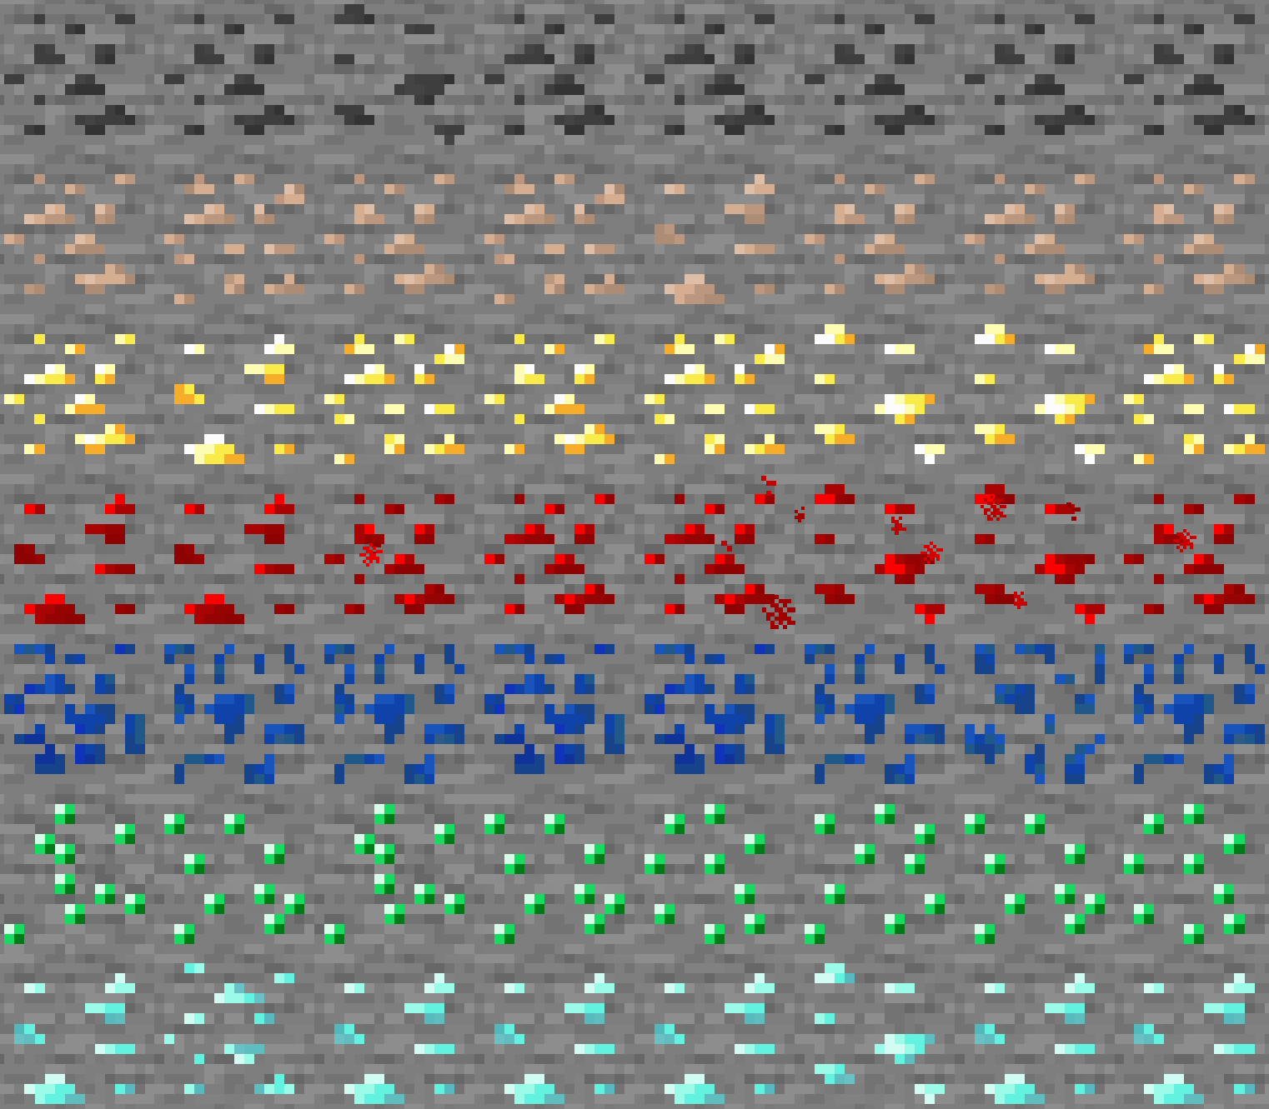
Little Improvements
Variated

Slide 2
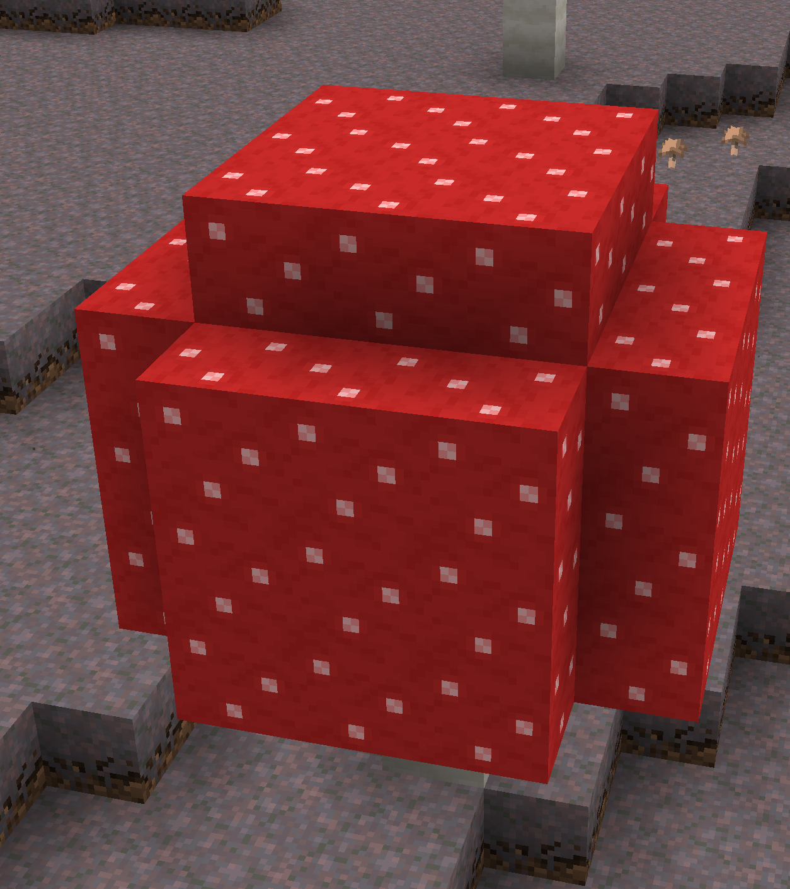

With Little Improvements: Variated
Vanilla

Slide 3


With Little Improvements: Variated
Vanilla

